Slide 1
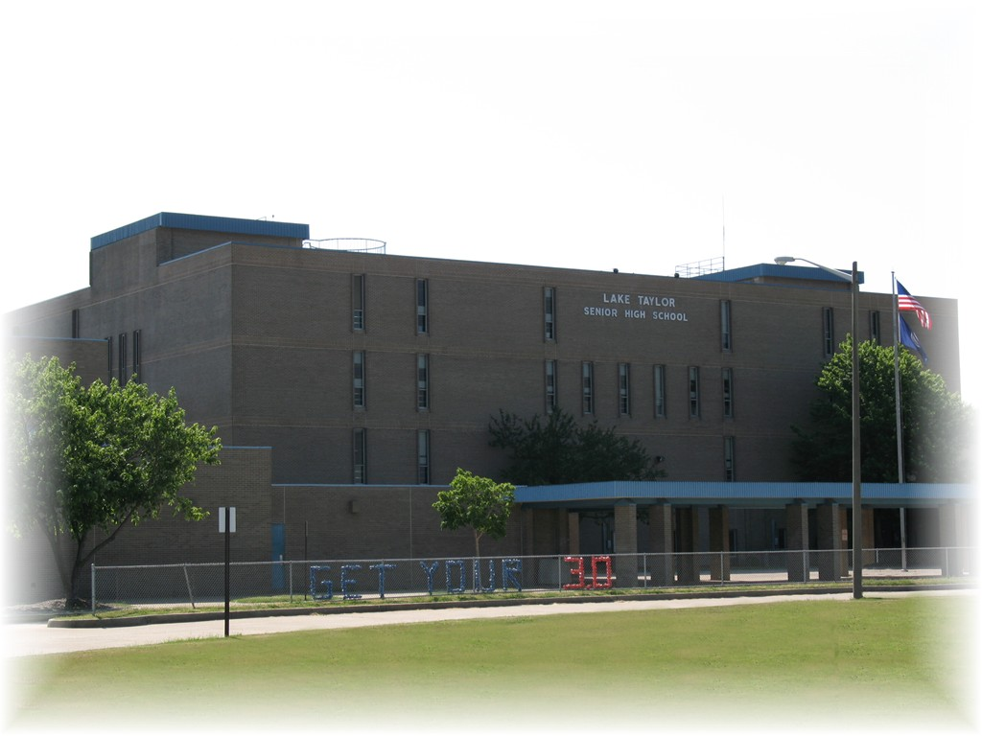
Covid-19 Return Plan for Athletics and Activities

Slide 2
Objectives
Review athletics and activities offerings with revised VHSL timeline
Provide contact information for coaches and sponsors
Review requirements for participation in athletics
Physical Examination
Parent and Student Concussion Education
Parent and Student Covid-19 Education
Review of Covid-19 mitigation strategies for return to athletics and activities
Q&A

Slide 3
Winter Sports – Season 1 December 16 – February 20
Varsity Boys’ Basketball
Derek “Yogi” Edwards
dedwards@nps.k12.va.us
Varsity Girls’ Basketball
Saundra Sawyer
ssawyer@nps.k12.va.us
JV Boys’ Basketball
Brett Jones
bjones6@nps.k12.va.us
JV Girls’ Basketball
Dominic Perry
mrperry15@yahoo.com
Girls’ Swimming
Cassidy Banzer
cassidy_glass@hotmail.com
Boys’ Swimming
TBD
cassidy_glass@hotmail.com
Varsity Sideline Cheer
Elita Rushin
e-rushin@outlook.com
JV Sideline Cheer
Shacora Highter
shighter@nps.k12.va.us
Boys’ and Girls’ Indoor Track
Spencer Jamison
sjamison@nps.k12.va.us
Jasmine Cuffee
jcuffee@nps.k12.va.us
Wrestling
Angelo Patillo
a.patillo89@ymail.com

Slide 4
Fall Sports – Season 2 February 15 – May 1
Varsity Football
Hank Sawyer
hsawyer@nps.k12.va.us
JV Football
Lamont Britt
lbritt3@nps.k12.va.us
Girls’ Volleyball
Jasmine Cuffee
jcuffee@nps.k12.va.us
Boys’ Volleyball
Marquisha Poole
mpoole842@gmail.com
Boys’ and Girls’ Cross Country
LaShundra Carter
lacart@nps.k12.va.us
Golf
Dr. Ralph Gee
rgee@nps.k12.va.us
Varsity Sideline and Competition Cheer
Elita Rushin
e-rushin@outlook.com
JV Sideline Cheer
Shacora Highter
shighter@nps.k12.va.us
Field Hockey
TBD
rpannenb@nps.k12.va.us

Slide 5
Spring Sports – Season 3 April 12 – June 26
Baseball
Andy Castro
andrescastro0088@gmail.com
Softball
TBD
rpannenb@nps.k12.va.us
Boys’ Soccer
TBD
rpannenb@nps.k12.va.us
Girls’ Soccer
Linda Heck
lindaheck29@gmail.com
Boys’ Tennis
TBD
rpannenb@nps.k12.va.us
Girls’ Tennis
Jasmine Cuffee
jcuffee@nps.k12.va.us
Track and Field
Spencer Jamison
sjamison@nps.k12.va.us
Tiran Matthews
tmatthews@nps.k12.va.us

Slide 6
Activities
Scholastic Bowl
Charles Guido
cguido@nps.k12.va.us
Yearbook
Chris Joyner
cjoyner@nps.k12.va.us
Forensics
TBD
rpannenb@nps.k12.va.us
One Act Play
TBD
rpannenb@nps.k12.va.us
Band
Paige Driver
pdriver@nps.k12.va.us

Slide 7
Requirements for Athletic Participation
Academic Eligibility
ALL incoming freshmen are academically eligible for 2020-2021
Physical Examination
Must be signed by healthcare provider and dated 5/1/2020 or later
Concussion Education
Watch concussion education video and sign
Covid-19 Education
Watch NPS Covid-19 Mitigation video and sign
All information and videos available on our athletics webpage:
laketaylor.rschoolteams.com

Slide 8
A safe Athletic Return
This Photo by Unknown author is licensed under CC BY-ND.

Slide 9
NPS Safe return for students and Staff
Daily sign/symptom screening for ALL coaches, staff, and student-athletes.
Daily temperature checks for ALL coaches, staff, and student-athletes (must be below 100.4).
Daily attendance will be taken to assist with contact tracing as needed.
Masks must be worn at all times by coaches and staff, and any athlete not actively participating in a drill. Masks will be provided and must be worn by student-athlete when on the sideline, common areas, etc.
Social Distancing: minimum distance of 6 feet between all persons, or 10 feet when engaging in athletic activity
All equipment being utilized by multiple participants will be cleaned and sanitized between use. Use of individual equipment will be encouraged.
Athletes must bring their own water bottles for personal use during workouts.
All spaces being used by any individual or team will be properly cleaned and disinfected daily after use.
Hand sanitizer, wipes, and disinfectant solution will be available at all workouts. Regular, proper handwashing will be encouraged.

Slide 10
Thank you!
We look forward to meeting you soon! Please direct all additional inquires regarding athletics and activities to the following:
Bobby Pannenbacker, Athletic Director
Cell: (757) 685-3888
rpannenb@nps.k12.va.us

